Slide 1

RECOMMENDER SYSTEM CHALLENGE 2018/2019

Slide 2
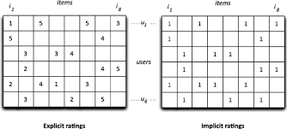
PROBLEM IDENTIFICATION
EXPLICIT VS IMPLICIT

Slide 3
Algorithms implementation
Content-Based Filtering
Item-Based Collaborative Filtering
User-Based Collaborative Filtering
Light Factorization Machine
SLIM RMSE with Side Information
SLIM BPR
ALS Matrix Factorization
Pure SVD

Slide 4
hybridization
UB CF
IB CF
SSLIM
SVD
HYBRID
CBF
ALS MF
LIGHT FM
BPR

Slide 5

Thanks for the attention
Lamparelli Andrea 10490088 Chittò Pietro 10458917

